Slide 1
A HYBRID AND SMART APPROACH TOWARDS RENEWABLE ENERGY CAPACITY ADDITION
18th Renewable Energy Summit
16th November 2018
Presentation by
Dr. (Mrs. ) Malti Goel

Slide 2
Overview
I would like to put before you a five new technologies of relevance to our country to address the theme of the Summit.
Floating Renewable Energy Platforms
Hybrid Energy Systems
HRES with V2G Integration
Metal Air Batteries
Solar Energy Storage in Water

Slide 3
Global Renewable Energy Scene
18th Renewable Energy Summit
Renewable energy is poised for a global takeoff. Over the past decade, the installed capacity of solar power has increased seven-fold, and wind energy capacity has grown by more than a factor of 13.
Wind and solar power are the world’s fastest-growing energy sources, with capacity expanding at double-digit rates every year over the current decade
Six countries—Denmark, Germany, India, Japan, Spain, and the United States—account for about 80 percent of global photovoltaic (PV) and wind power capacity

Slide 4
India’s energy in 2010 and Capacity Addition in 2017

Slide 5
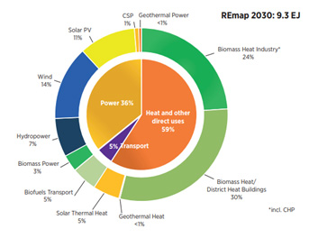
Global wind capacity and Solar capacity
Global Renewable Energy Capacity became 1081GW with China having highest share as a country with one third share of 334GW in 2017
India achieved 61 GW and retained 5th Position, beating Japan at 57 GW
According to Renewable Energy Prospects report Renewable power will maintain its strong growth in the Indian market reaching 35% share of generation, and 60% share of power generation capacity by 2030

Slide 6
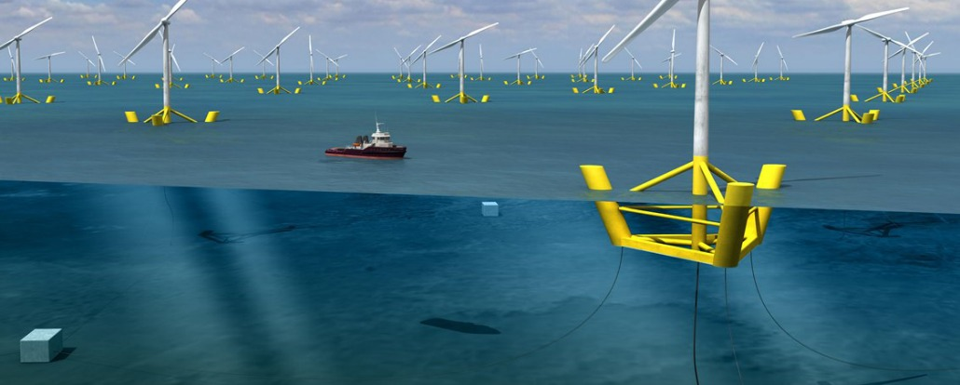
1. Floating Wind Turbines
Floating wind turbines are anchored to the seabed using cables without a fixed foundation, meaning they can be placed in water up to 600m, as opposed to 60m

Slide 7
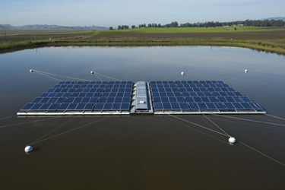
Floating Solar Plants
Floating solar plants had higher efficiency compared to ground-mounted installations due to the moderating effect of water bodies on panel temperature

Slide 8
2. Hybrid Energy Systems
Hybrid Energy System (HES)s are gradually getting popular for both grid connected and standalone applications as an eco friendly, economical solution.
It requires evolutionary algorithm to arrive at optimum system design considering level of grid integration as a constraint.
Hybrid Systems allow minimize CO2 emissions

Slide 9
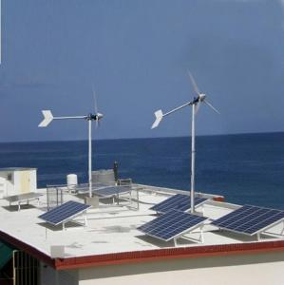
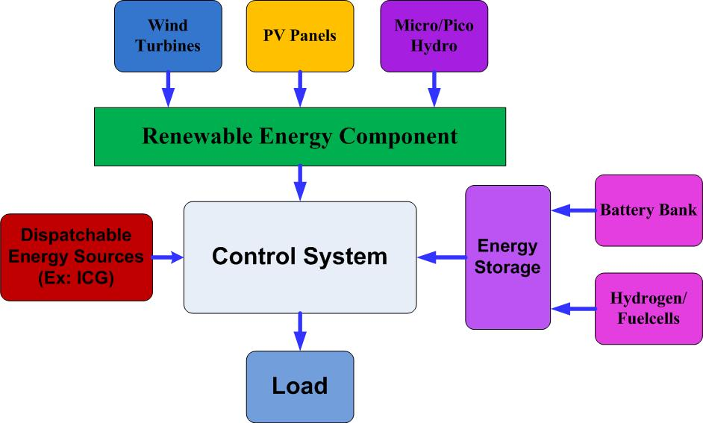
Hybrid Energy Systems
Hybrid Energy Systems bring efficiency

Slide 10
3. Integration of V2G Concept in Smart Energy Systems
Uncertainty of main grid due to changes in demand, increasing renewable energy potential and need for charging of electric vehicles makes it difficult to optimize renewable energy systems with V2G
A number of case studies have been conducted in different parts of the world in order to evaluate the economical feasibility of V2G concept in smart energy systems

Slide 11
Hybrid Renewable Energy Systems with V2G
A HRES with V2G consist of SPV panels, wind turbines, V2G charging center and the main grid which supply the electricity demand of an application such as a supermarket or a cluster of houses.
Hourly variation of renewable energy potential, V2G fleet capacity for charging/discharging and electricity demand of the micro-grid are taken as major input parameters to the energy model.
A novel computational algorithm is developed to optimize smart HRES with V2G.

Slide 12
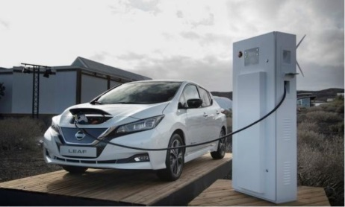
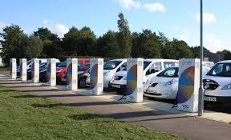
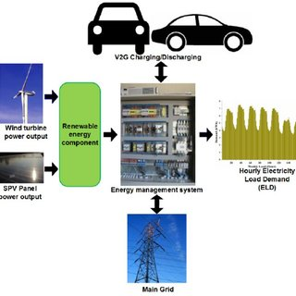
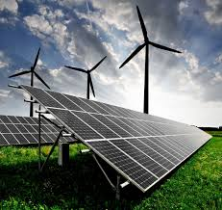
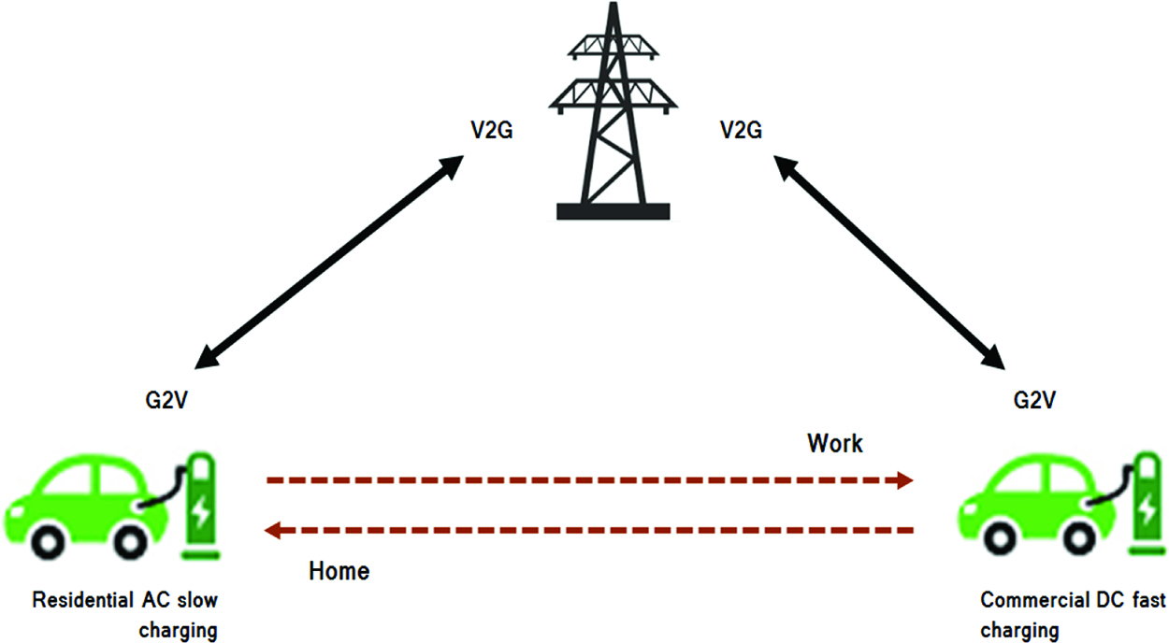
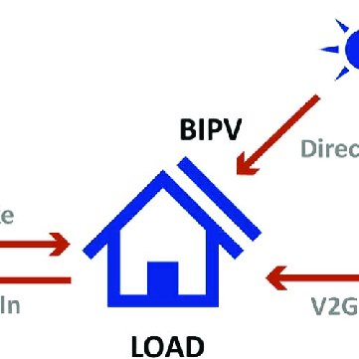
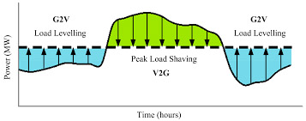
V2G Integration in Smart Grid

Slide 13
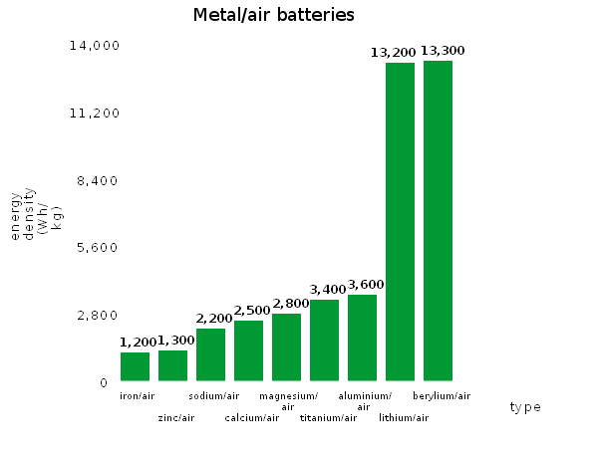
4. Metal Air Battery Storage for Vehicles
A typical lithium-ion battery can store 150 watt-hours of electricity in 1 kilogram of battery.
A lead-acid battery stores only 25 watt-hours per kilogram.
https://upload.wikimedia.org/wikipedia/commons/1/13/Metal_air_batteries_barchart.png

Slide 14
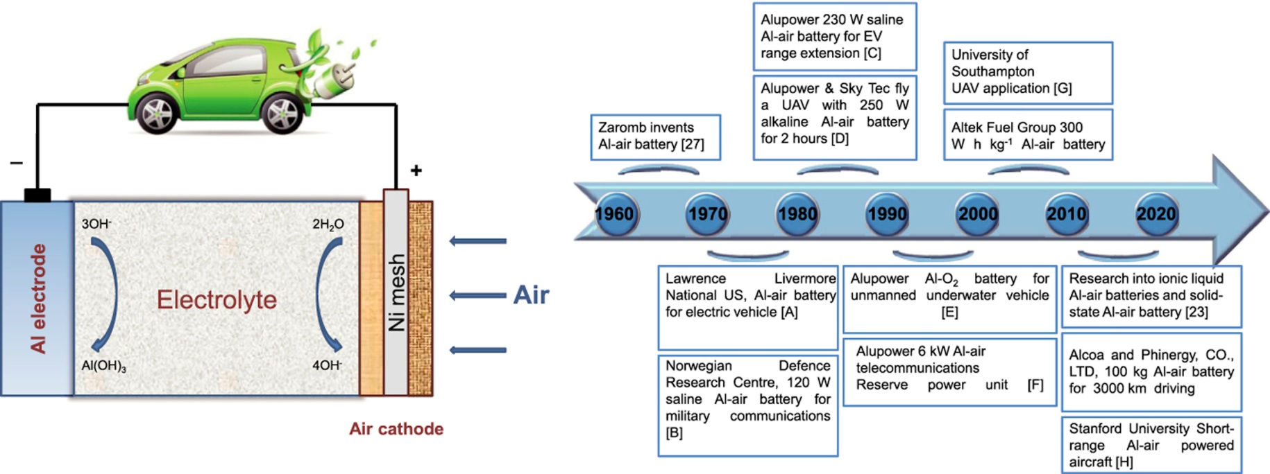
Metal Air Battery for Energy Storage
The aluminum–air battery is considered to be an attractive candidate as a power source for electric vehicles (EVs) because of its high theoretical energy density (8100 Wh kg⁻¹)

Slide 15
5. Research on Solar Power Storage in Water
NB Institute for Rural Technology (NBIRT), has come up with a prototype of machine that will store solar power in water for 24 hours
It has a solar panel, a micro-solar pump, a micro-hydel equipment, a water tank and a water reservoir.
solar power is first stored in the underground reservoir and then pumped into the overhead water tank and stored as potential energy.
Micro-hydel equipment is then switched on and that will bring the high-pressured, stored solar-powered water into the main machine, which will turn it into electricity.

Slide 16
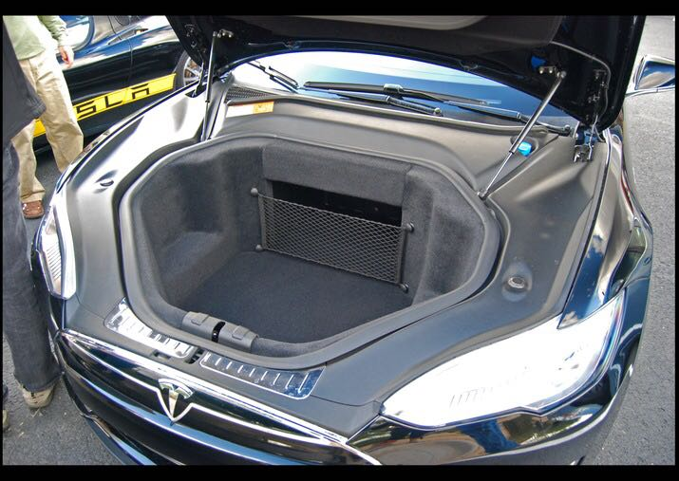
Shape of things to come. Bonnet of an Electric Vehicle
Thank You

